Slide 1
Protecting the Accessible
Cryptography (crypto)/encryption protects information even when it is not under your physical control
Files, disks, network traffic
At rest
In transit
Also for identity
Protect keys
Why not encrypt everything fully?

Slide 2
Chapter 10 Overview
Digital networking and reliable transmission
Building and operating a small-scale LAN
Reliability and error detection
Network protocols and the protocol stack
Network applications and resource sharing

Slide 3
Potential Networking Risks
Physical theft of network hardware
Subversion of network switches or wiring
Disclosure – sniffing of sensitive messages
Forgery – constructing a bogus message
Masquerade – lying about the message source
Denial of service – make the net unusable

Slide 4
An Example: Sharing a Printer
The Old Masonic building tenants share a LAN with a printer
Requirements
All tenants shall contribute for utility bills and supplies
All tenants shall have use of the shared network and printer
Access shall only be granted to tenants

Slide 5
Potential Controls
Physical – isolate the net from attackers
Mechanical – lock the building doors
Logical – restrict network traffic to the suite
Functional – provide no risky actions on the network
Procedural – only suitemates have keys to the suite
Cryptographic – use encryption to protect the network

Slide 6
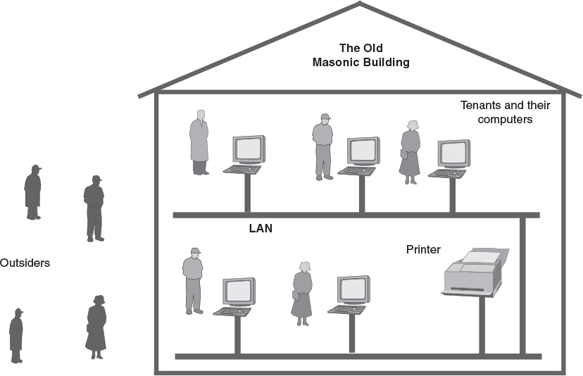
Physical Network Security

Slide 7
Host and Network Integrity
Network worms
Like the Morris worm, only up-to-date
Use the latest Internet vulnerabilities
The botnet risk
A botnet is a network of subverted computers
Malware embeds special software
Allows a botnet herder to operate the subverted computers (“bots”) remotely
The bot software is hard to detect

Slide 8
Transmitting Information
Message switching – send whole messages
Sending and receiving are independent
Recipient gets all of message or nothing
Message size limits and longer delays
Circuit switching – connect two speakers
Send and receive one or many messages
Sender and recipient must both be available
Packet switching – send message in pieces
More efficient, but requires complex endpoints

Slide 9
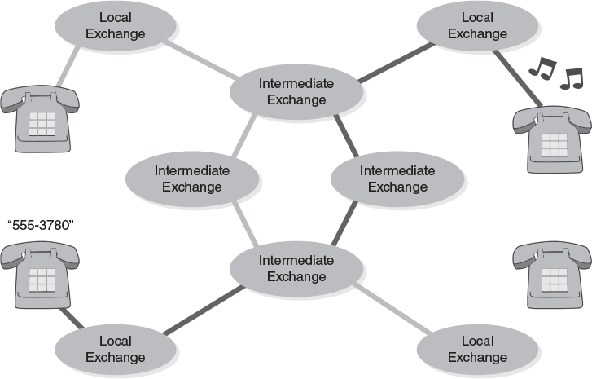
Circuit Switching

Slide 10
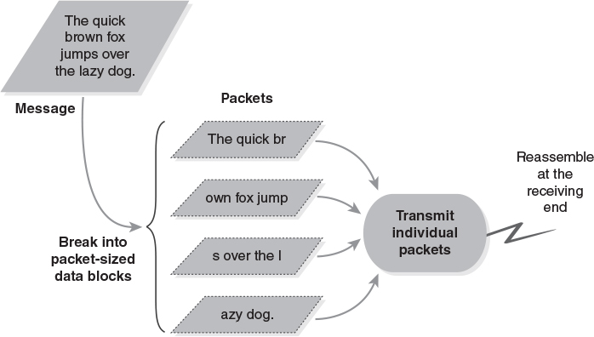
Packet Switching

Slide 11
Packets Are Like Postcards
Easily carry short messages
Longer messages broken into segments
Recipient must reassemble the messages
Each message has a header that contains
Destination address
Damage detection, like a checksum
Data to carry
Sender's address: Optional and unreliable

Slide 12
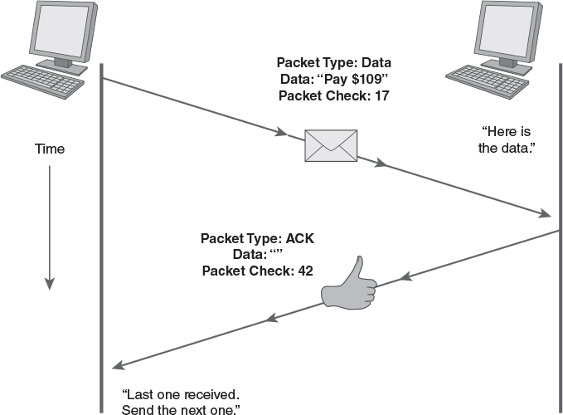
Transmitting Packets Reliably

Slide 13
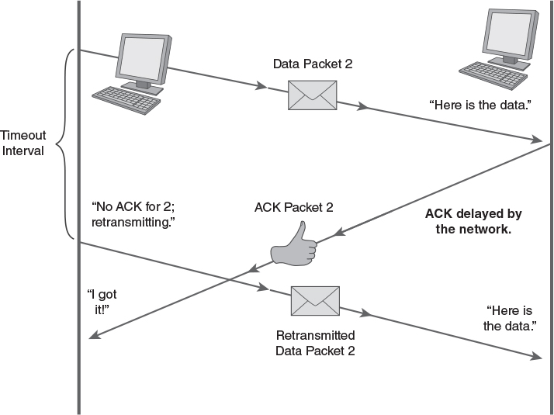
Packet Duplication

Slide 14
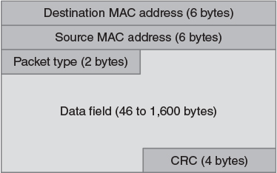
Packet (“Frame”) Format

Slide 15
Packet Contents
Source and destination “MAC” addresses
Two-part address, unique across all networks
3 bytes indicate the interface manufacturer
3 bytes indicate specific interface
All hosts hear all packets
Hosts discard all packets not for them
Packet type – indicates the type of message it carries
CRC – an error detection code

Slide 16
Finding a MAC Address
Keyboard commands
Windows MSDOS: ipconfig
Unix/Linix/Mac OS X: ifconfig
Graphical interface
Windows: Via Network and Sharing Center
“Details” under “Network Status”
Mac OS: Via Network System Preferences
“Ethernet tab” under the “Advanced” button

Slide 17
Building a LAN/Ethernet
Most use twisted pair wire: Cat 5, 5+, or 6
Connections are from hosts to network “nodes” that pass the traffic between hosts
A node “downlink” connects to a host
A node “uplink” connects to other parts of the network
Two types of nodes in typical small LANs
Hubs: broadcast to all hosts
Switches: connects hosts pairwise, managable

Slide 18
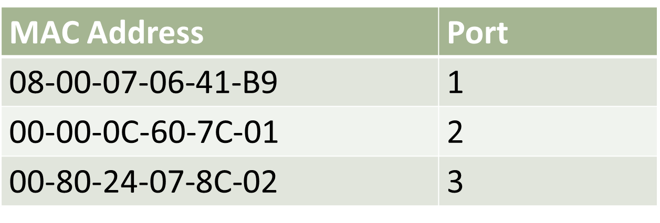
LAN Traffic
Physical Address – MAC
frames sent on LAN (broadcast domain)
Ports – switch/hub ports
table on switch (show mac address-table)
mapped to MAC addresses
sent out to all ports on hub

Slide 19
LAN Traffic
IP Address – Virtual
LAN addresses saved locally in ARP cache
arp –a
Packets sent to router port (gateway) to reach other LANs

Slide 20
Network Protocol Software
We organize network software in layers
The layers form the protocol stack
Lower parts (network device drivers) may be in kernel mode
Higher parts are privileged OS programs
Highest parts are user application programs

Slide 21
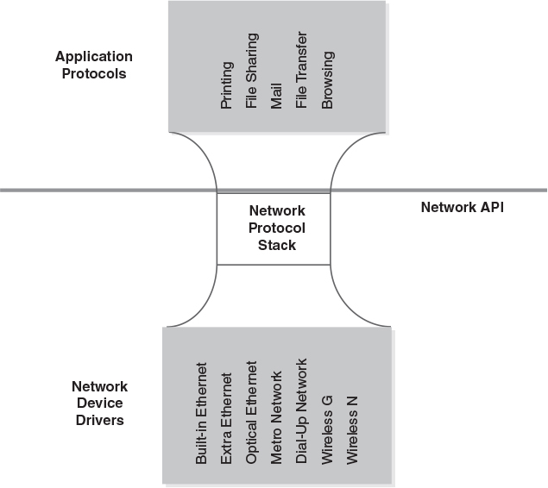
Protocol Stack

Slide 22
A Simple, LAN-Oriented Stack
Top layer: Application layer
An API is provided between the application programs and network software built into the OS
First layer below the API: Transport layer
Links processes between hosts
Next layer: Link layer
Builds packets to travel between hosts
Bottom layer: Device drivers/physical layer
Actually transfers data to physical devices

Slide 23
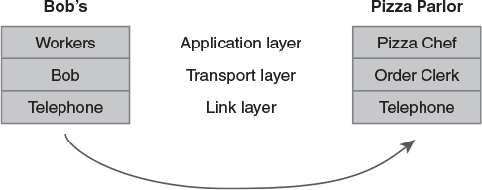
Layering Example: Ordering Pizza

Slide 24
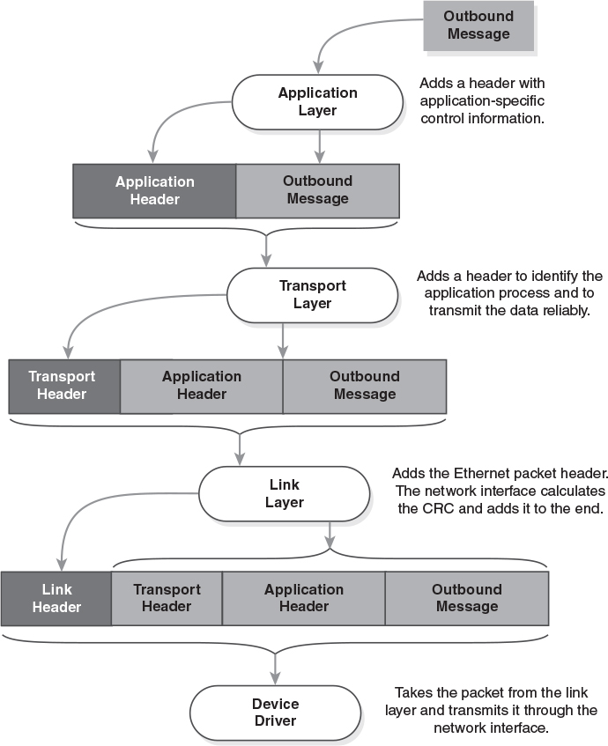
Packet Formats and Protocol Stacks

Slide 25
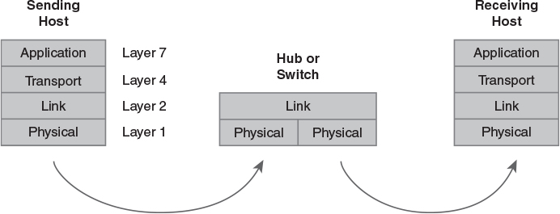
Layers in a Simple LAN

Slide 26
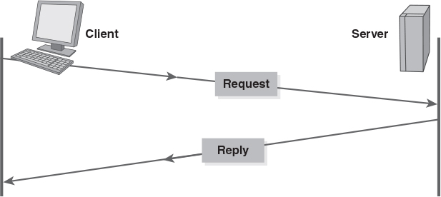
Network Applications: Client/Server

